Slide 1
Bargain Radar
Group C11
Majd Sehwail, 2096507 Mariusz Szmajduch, 2089488 Ivaylo Zhelev, 2026929 Ivan Kulazhenkov, 2093731

Slide 2
Main functionalities
Bargain radar allows small businesses to post their discounted deals.
Deals are sorted into categories.
Customers can surf through these deals but they have to be registered as customers and users who wish to advertise are registered as clients.
Customers can add different deals into their baskets. These are claimed through transactions.

Slide 3
User Persona, Jenny
Name: Jenny
Job Title: Bank accountant
Technical comfort: Average
Type: Customer
Background: -works in a bank -single mother -average salary -very busy
Motivations: -She wants to save on money -She wants to invest her time
Frustrations: -has no time to look for deals -most websites she surfed are specific -gets frustrated with complicated websites
What would be her ideal experience?

Slide 4
User Persona, Steve
Name: Steve
Job Title: DVD store owner
Technical Comfort: Average
Type: Client
Background: -Owns a DVD store -His business is not doing so well
Motivations: -He has many deals to promote -he wants to manage his deals’ advertisements by himself
Frustrations: -He doesn’t like procedures -His advertisements get overshadowed by other ones
What would be his ideal experience?

Slide 5
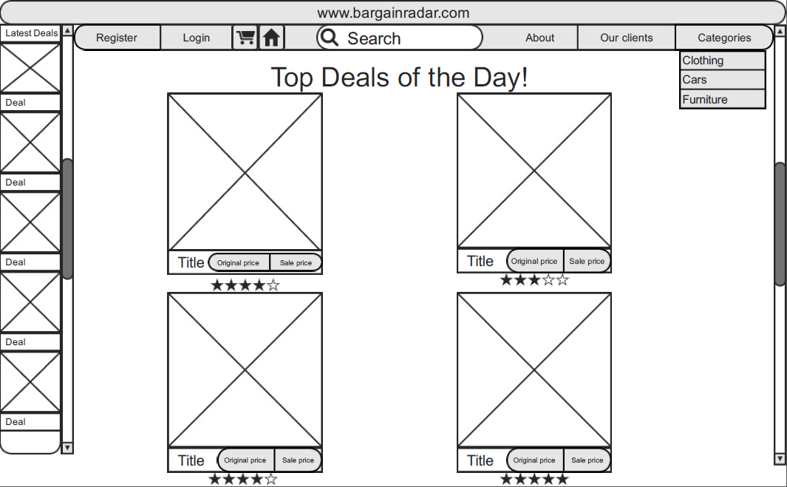
WireFrame, Home page

Slide 6
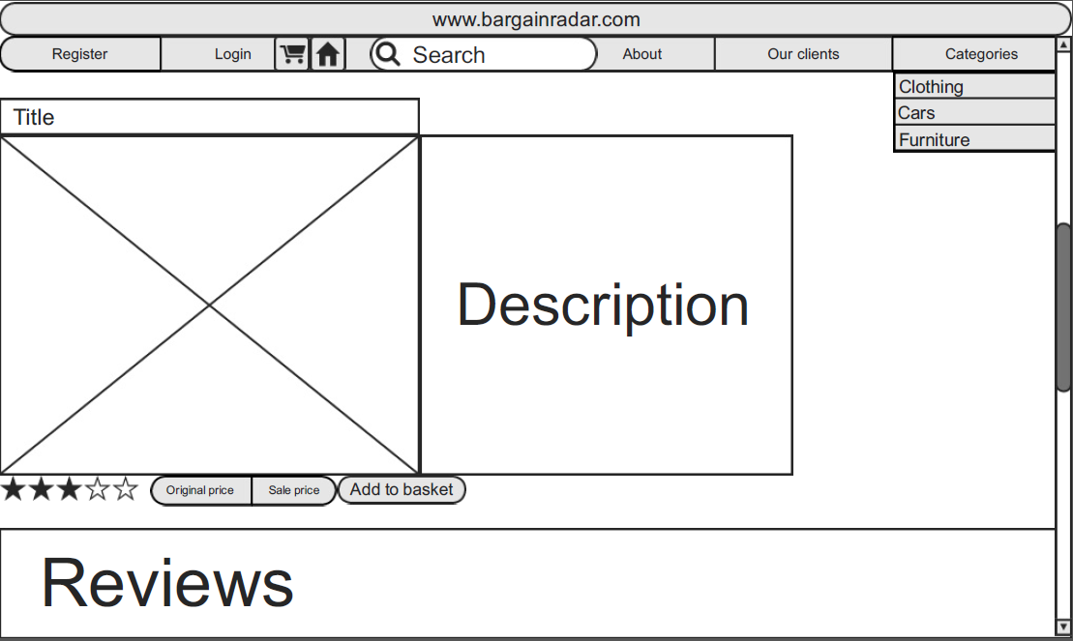
WireFrame, Deal page

Slide 7
What makes our website stand out?
Our website supports small businesses that are overshadowed by bigger corporations.
We give total control to our clients.
Our deals are exceptional and are from a wide range of various categories.
Bargain radar has a simple friendly user interface.

Slide 8
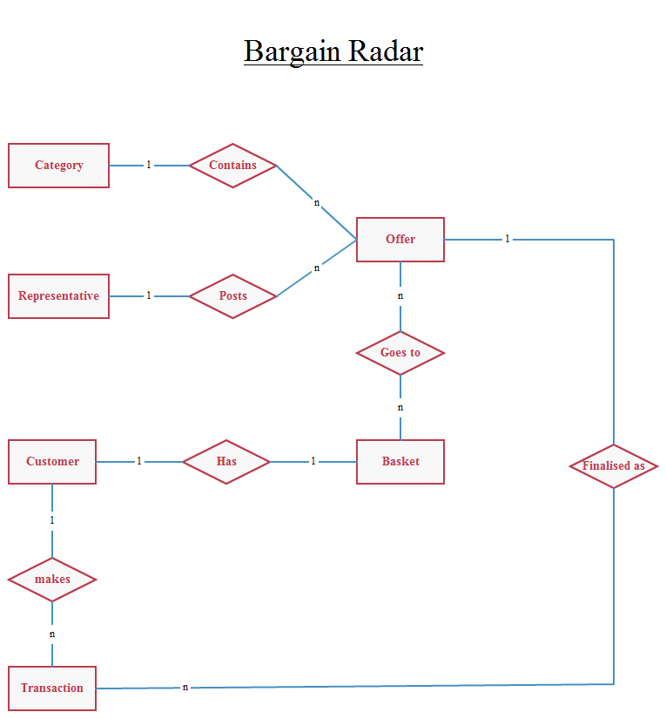
ER Diagram

Slide 9
MoSCoW Analysis
M: Simple User Interface
All Categories on one site
S: Representative Autonomy
Small Business Exclusive
User Rating by Popularity
C: Transaction less Checkout
Secure Login
W:Large Corporation Deals included

Slide 10
User Needs Matrix
App Functionality | User-Jenny | Client-Steve
Simple User Interface | 4/5 | 3/5
All Deal Categories on one site | 4/5 | 1/5
Representative autonomy | 1/5 | 5/5
Small Business Exclusive | 2/5 | 4/5
User Rating by Popularity | 3/5 | 2/5
Relative importance rating system where 5/5 is very important and 1/5 is indifferent.
Several compromises have to be made however, due to functionalities not being acceptable to both parties

Slide 11
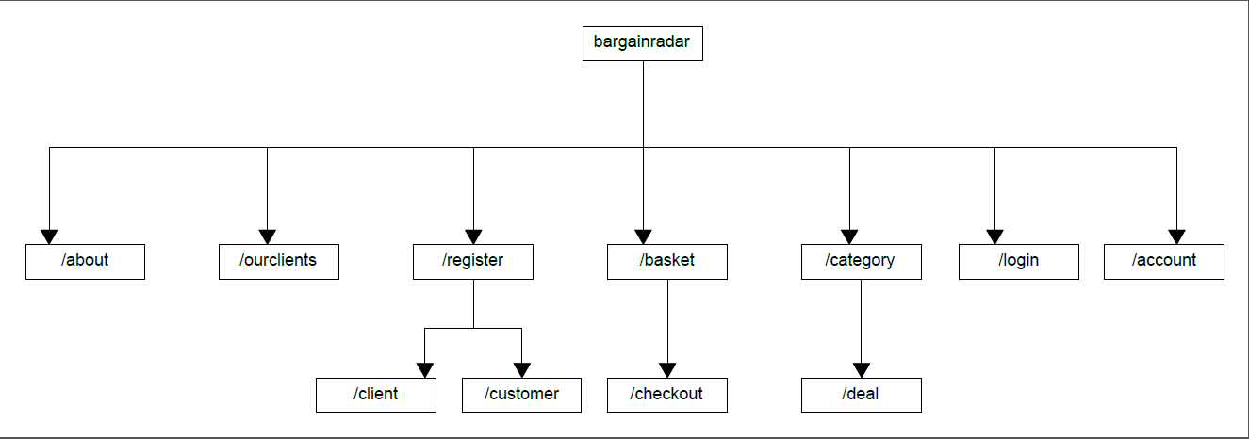
URL Site map

Slide 12
